Slide 1


ALC ALERT !!
Sober Driving Today. Alive Tomorrow.

Slide 2
About Us
Impairment is not reliant upon the type of alcohol consumed, rather the number of drinks over a certain period of time. Despite myths and misconceptions, coffee, a cold shower, or exercise will not make a person more sober; only Time will.
On average, a drunk driver will drive 80 times under the influence of excess alcohol.
Every 76 minutes in India, someone is killed in a drunk driving crash. That equates to 19 People every day.
For drivers under 21, our country has a No Tolerance policy that does not allow any alcohol to be in the blood system while behind the wheel. The consequences could include Expensive Fines, loss of license or jail.
SO…RETHINK YOUR NEXT DRINK !!
Ours is an attempt to eradicate the vulnerable cause of “DRINK AND DRIVE” by developing a Web Application.

Slide 3
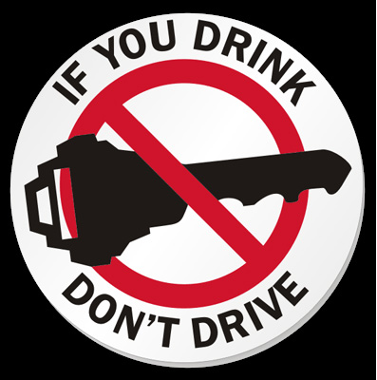
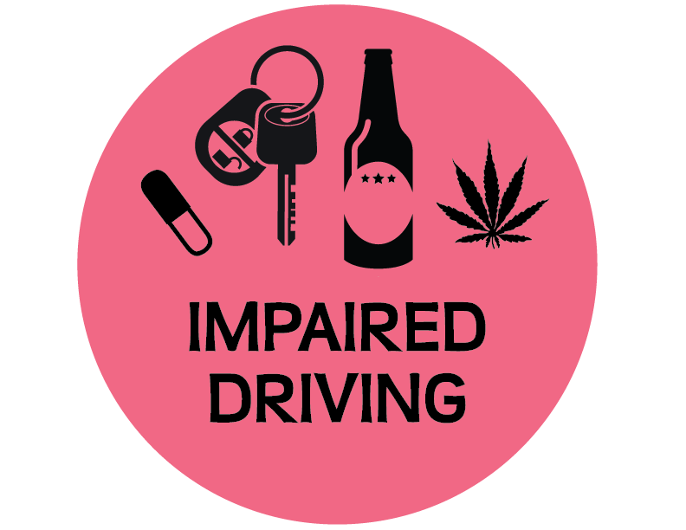




Yours’at STAKE :-
FUTURE
TRUST
PENALTY
Your FUTURE at STAKE
You’re FOOLING no one but YOURSELF
Your LIFE at STAKE.

Slide 4
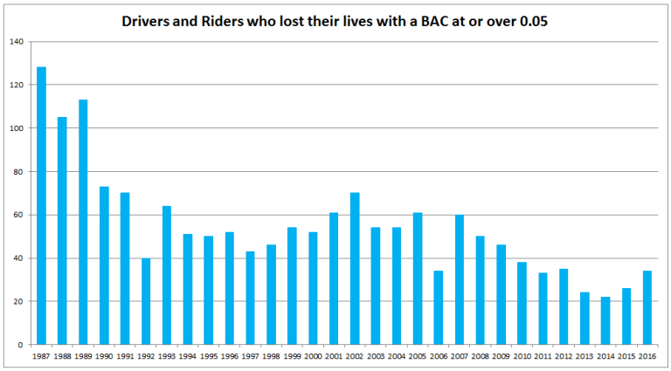
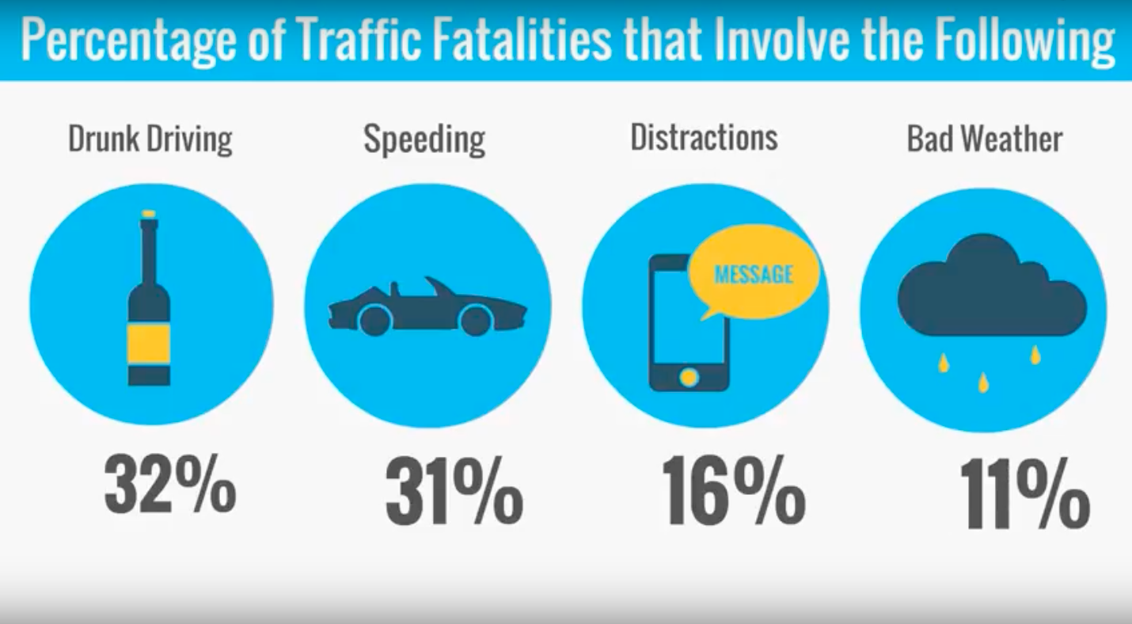
Stats :-
Blood Alcohol Content (BAC) The concentration of alcohol in the blood, expressed as the weight of alcohol in a fixed volume of blood and used as a measure of the degree of intoxication in an individual.

Slide 5





Solution
Prioritize
Authorize
Decide
LIVE SLIDE OF THE WEB APPLICATION – (NEXT SLIDE)
Link to the Website –
http://alc-alert.000webhostapp.com
You can hand over your keys or your life
Make the right choice !!

Slide 6

Notes:
LiveSlide http://alc-alert.000webhostapp.com/

Slide 7





SQUAD :-
Swapnil Narayan
Kumar Kshitij
Team Leader
Sparsh Srivastava
Harsh Gupta
Sanchay Goel
TEAM BABES GOT BYTE

Slide 8



Thank You
Swapnil Narayan
7864024344
swapism7@gmail.com

